Slide 1
Crop Production Data Analysis in India
Understanding Trends and Patterns

Slide 2
Introduction
India's economy relies heavily on agriculture, making data analysis crucial for assessing its performance.
Identify potential shortages or surpluses to ensure food security and promote sustainable agriculture.
Optimize resource allocation for effective agricultural planning, enhancing overall productivity.
Analyze historical data to adapt to climate change, ensuring resilience in agricultural practices.

Slide 3
Data Overview
The Key variables in the provided data are as follows:
State Name
District Name
Crop Year
Season
Crop
Area
Production

Slide 4
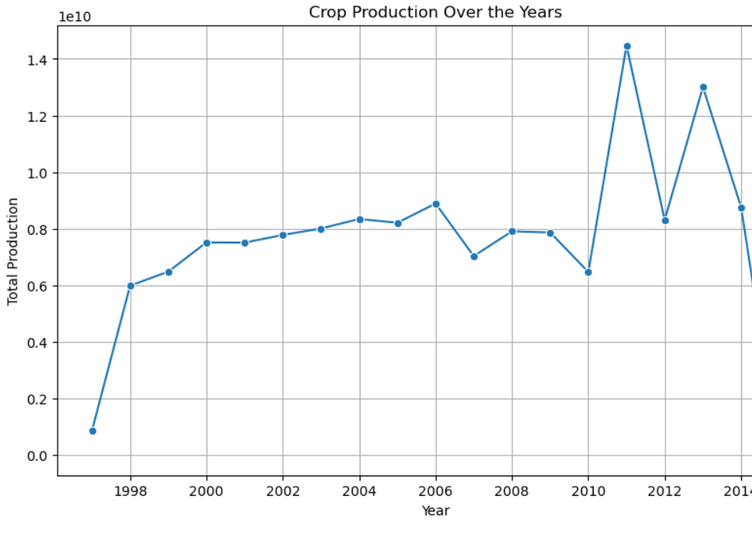
Crop Production Trends Over the Years
As we can observe the graph from year 1998 – 2010 remained constant and trends rise heavily in the year 2010 – 2013.
This trends shows us the gradual improvement in the crop production in India.
Due to new technologies in agriculture field the production is increasing day by day.

Slide 5
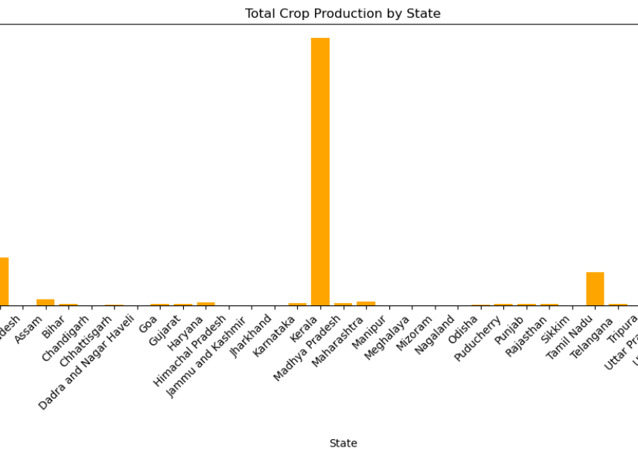
State-wise Analysis
The state with Production in India is Kerela with Coconut as their main crop.
Followed by states Andhra Pradesh and Tamil Nadu.
This bar chart shows that crop production is more in southern part of india due to the tropical climates.

Slide 6
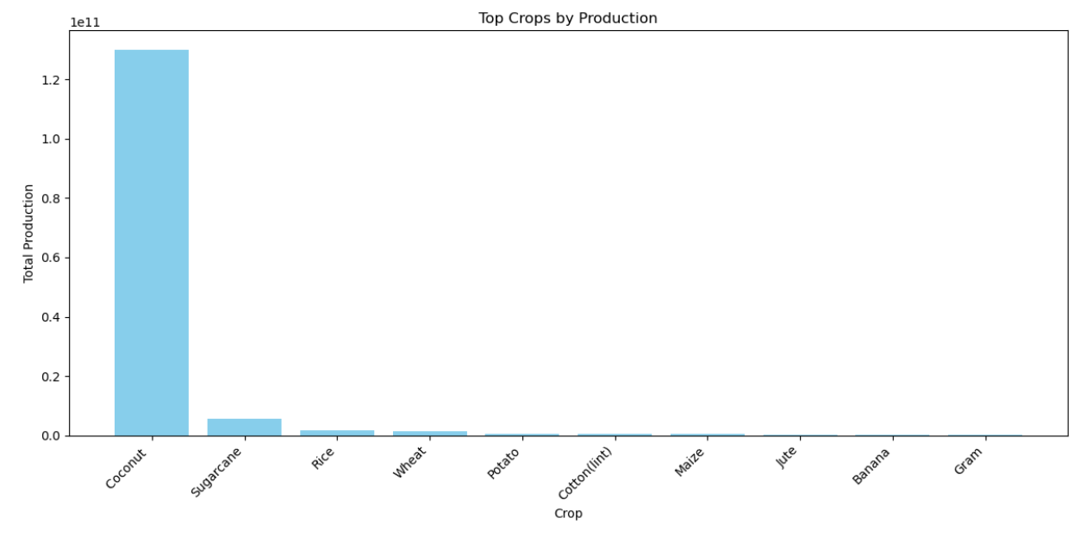
Top Crops by Production
This Bar chart shows the top 10 crops yields in India.
Coconut is the most produced crop in India followed by sugarcane, rice and wheat etc.

Slide 7
Insights and Findings
Production peaked during year 2011-2013, Namely Coconut Crop in Kerela state.
The Crop production is affected by various factors like climatic conditions and many other reasons based on the various regions of crops
Even though coconut is largely produced they are still other crops which are produced at adequate amounts balancing the crop production in India.
This analysis helped us mainly to gather information on various crop production in the last decade or more in different states across the nation.

Slide 8
Conclusion
The analysis revealed crucial insights into crop production trends, emphasizing the importance of data-driven decision-making in agriculture.
Disparities in crop production among different states highlight the need for targeted interventions and support in underperforming regions.
The analysis underscores the pivotal role of States and their Crops in shaping overall production trends.
Vince Raavi

